Slide 1


DATA PREPROCESSING USING PCA

Slide 2
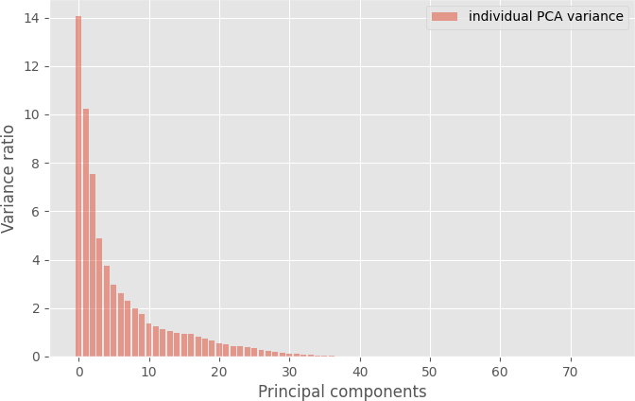

Slide 3
As there are as many principal components as there are variables in the data, principal components are constructed in such a manner that the first principal component accounts for the largest possible variance .
These are the principle components. From above figure , It looks like around 5 or 6 of the PCA features explain the majority.

Slide 4
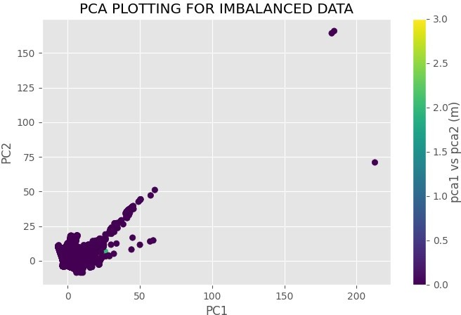

Slide 5
After converting the PCA features into the 2 top features. (We can change this value to other value). We'll then plot a scatter plot of the data point classification based on these n number of features. The above figure shows this scattering of data points.

Slide 6
